Slide 1
Federal Health Architecture Federal Health Information Model (FHIM)
Presentation for S&I Framework DAF/SDC/CQF
Tiger Team Meeting
July 1, 2014

Slide 2
AGENDA
Introductions
FHIM overview (governance, change process and resources)
FHIM domains and classes (how determined and flexible)
How FHIM domains align with DAF spreadsheet
How FHIM could be made ISO 11179 compatible
Current FHIM efforts to map to all S&I Framework Data Elements and to FHIR
2

Slide 3

Overview - FHA/FHIM Governance Structure
FHA Governing
Board
Strategic Direction and Oversight
FHA Director
FHA Managing Board
FHA Advisory Group
Planning and Management
Health Information
Modeling WG
Collaborative cross-agency work on specific areas of FHA strategic focus. Technical WGs would be disbanded as priority issues are resolved and new groups would be formed as priorities are agreed upon.
Collaboration & Coordination
Workgroup
Directed Exchange & Interoperability WG

Slide 4
FHIM Overview Change Process and Resources
Change Process - FHIM and associated value sets use version control and unique IDs
Open Health Tools Collabnet site is the repository for FHIM models and other artifacts
IBM Rational Software Architect is the information modeling tool; VSAC and CDC PHIN/VADS provide the authoring tools and repositories for value sets; VSAC used for all future work
Resources - 6 part-time contract resources; 1.33 FTE; lead information modeler, 2nd information modeler, terminologist, terminology analyst, implementation modeler

Slide 5
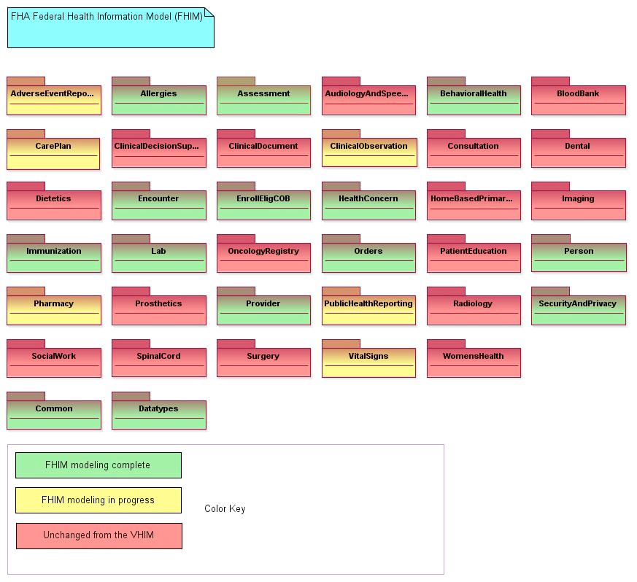
FHIM Domains and Classes

Slide 6
FHIM Alignment to DAF Spreadsheet
We examined the Data Access Framework (DAF) Initiative data element spreadsheet and found that the FHIM had 103 of the 109 concepts (94%).
Of these, 97 were exact matches, six were approximate matches (some differences in terminology value sets were noted, for example smoking status, or concepts that can be inferred in the FHIM by the class invoked – usually having to do with Order / Promise / Event).

Slide 7
FHIM and ISO 11179 Compatibility
FHIM Team members have been actively working with the Object Management Group (OMG), (the organization that “owns” the UML specification), in order to specify a standard extension to UML to add ISO 11179 capabilities to UML
The FHIM plans to “pre-adopt” this standard

Slide 8
FHIM Efforts to Map to Data Requirements of S&I Framework Initiatives
We retrospectively examined the Initiative data concepts and found that the majority of them were already in the FHIM
More importantly, we found that a FHIM concept often mapped to multiple Initiatives, indicating that multiple Initiatives were identifying the same concept over and over
This was especially apparent for Person / Provider demographics, “problem list”, allergies, and encounters.
Similarly, we noticed variances in value-sets identified for a single concept (in those cases where value-sets were identified)

